Slide 1
Trauma-Informed Suicide Awareness and Prevention
By Jasmeet Dhami, Christa-Lynn Flowers, Brad Oldale

Slide 2
Problem Statement
How can classrooms become spaces that support students impacted by suicide-related trauma while still meeting curricular objectives?
Students who experience trauma connected to suicide, whether through family, friends, peers, or the community, often come to school carrying grief, confusion, and pain. Traditional classroom practices and the curriculum tend to overlook these experiences, leaving students feeling isolated, stigmatized, and unsupported. Without intentional design, classrooms risk reinforcing this silence rather than providing spaces that foster healing, resilience and belonging.
Many students are indirectly or directly impacted by suicide or suicide related trauma
Feelings of isolation or invisibility can increase the risk of suicide and suicide related trauma. Ensuring students feel seen and validated can help students deal with these feelings.

Slide 3
Stakeholders
Students impacted by suicide-related trauma
Teachers who confront emotional triggers in the classroom
Parents of the at-risk students
School staff & administration
School board
Other community members (family members, health professionals, etc.)

Slide 4
Reframing
How can we accommodate for trauma-experienced youths in a communal school setting while minimizing the possibilities of re-stigmatizing the imbedded trauma?
By having teacher check-ins before, and through presence of adults and other professionals, our activity can normalize open conversations about student mental health
Morning meetings foster emotional safety and transparency, providing anticipation for potential triggers in school and social news (Pruitt & Kozik, 2022)

Slide 5
Reframing continued
Using the Third Space Framework and Indigenous ways of knowing and being to reframe our problem
The Third Space : is a way for educators to create hybrid learning environments where student's lived experiences and cultural narratives coexist with academic learning. This will open up safe spaces where personal and curricular knowledge intersect.
In Indigenous ways of knowing and being trauma and healing are collective experiences grounded in kinship and relational accountability.
A kinship frame invites educators to focus on relationships, storytelling, and community engagement as pathways to healing rather than solely clinical interventions.
Supporting students who have been impacted by trauma involves involving family, community, land, and culture in the learning process.
Gutiérrez, K. D. (2008). Developing a Sociocritical literacy in the third space. Reading Research Quarterly, 43(2), 148–164. https://doi.org/10.1598/rrq.43.2.3
Donald, D. (2022). A Curriculum for Educating Differently: Unlearning Colonialism and Renewing Kinship Relations , 62(2).

Slide 6
Reframing Continued...
When the challenge of supporting students affected by suicide-related trauma is reframed through Indigenous ways of knowing, the task becomes one of restoring relationships rather than fixing individuals. Healing is facilitated through community, connection, and storytelling, which are all essential aspects of this framework. According to the Third Space framework, the classroom should be a meeting place for students' personal and academic knowledge, where grief and resilience can be acknowledged and integrated. By rephrasing trauma support in these ways, we can gain a deeper understanding of how it is a holistic, relational, and culturally responsive process.

Slide 7
Brainstorming
Our group's initial brainstorming ideas for the activity:
  Student created a pamphlet that was researched for local support
    Opportunity for students to understand what supports are in the community for them
  Parent resource/info night
    Informs the parents on suicide-related issues on trauma, and ways to help their children.
  Wellness carnival
    Interactive activities that engage students while supporting and learning for students through trauma.
  Student-made suicide awareness poster creation
    Opportunity for students to understand the lasting effects of suicide on mental health.
  Student group research project on impacts of suicide
    Opportunity for students to collaborate in a group setting while learning and understanding the lasting effects of suicide on mental health.

Slide 8
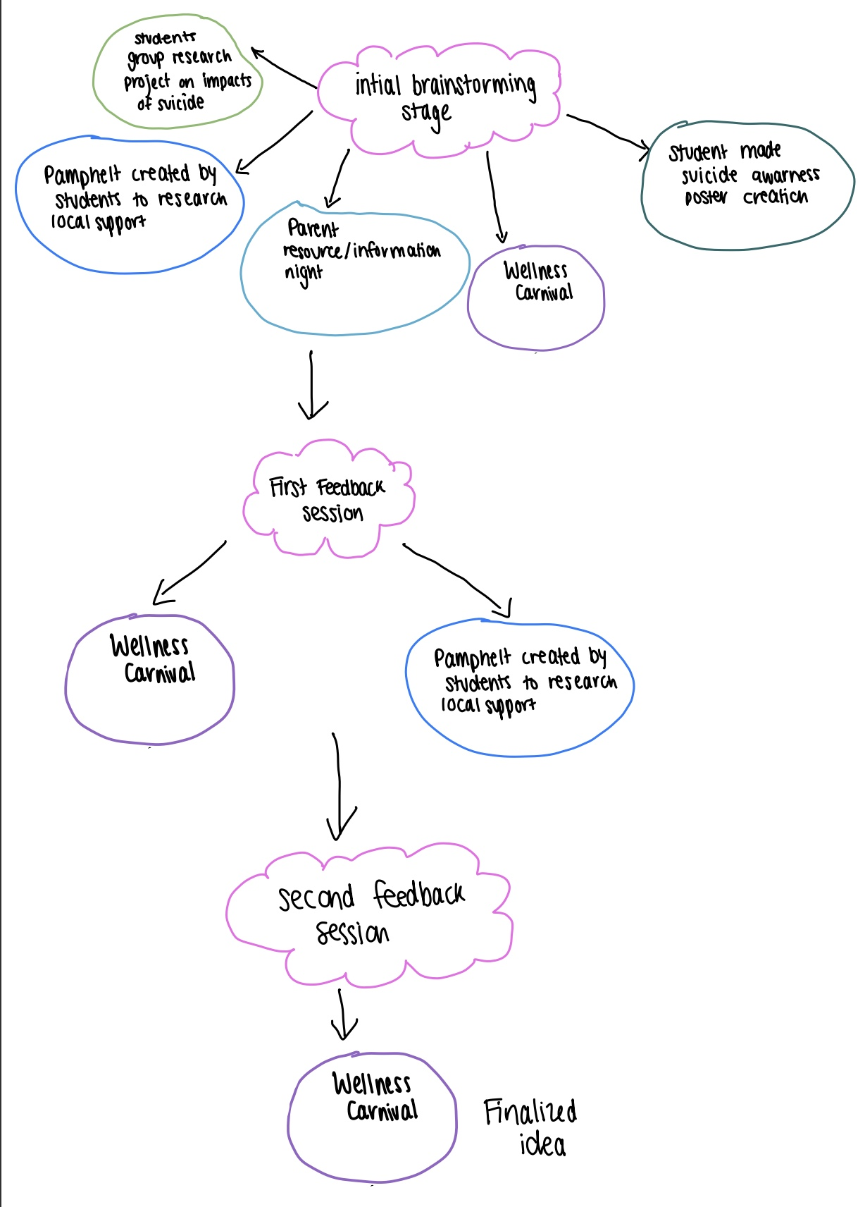
Convergence of Our Brainstorming
After our first feedback session, we narrowed it down to:
  Student created pamphlet that was researched for local supports
  Wellness carnival
Following the second feedback session, we decided to go with something more interactive and engaging for the students and agreed that the Wellness carnival would be a good choice.
  Additionally, we thought the carnival activity would best serve the interests of all the stakeholders involved in our problem.

Slide 9

Activity Description
Wellness Carnival
  Students will attend a carnival-type function in the school gymnasium
    There will be several stations that students can rotate through
    Students will be given a stamp card (the wellness bingo card) for all stations that can be turned in at the end, when filled, to be entered into a draw for a prize.
    All stations will have a Mental health and wellness professional, teacher and parent volunteer at them.
    All stations will be set up to facilitate an activity that helps mental health in some way, but also meets the program of studies.

Slide 10
Activity Description Continued
Wellness Carnival Stations
  Sharing Circle
  Coping Skills Tool Kit Booth
  Circle of Support Station
  Gratitude Graffiti Wall
  Mindful Minute Zone
  Energy Reset Challenge
  Hope & Strength Banner
  Kindness Mailbox
  Goal Tree
  Councilor Corner
  Resource booth

Slide 11
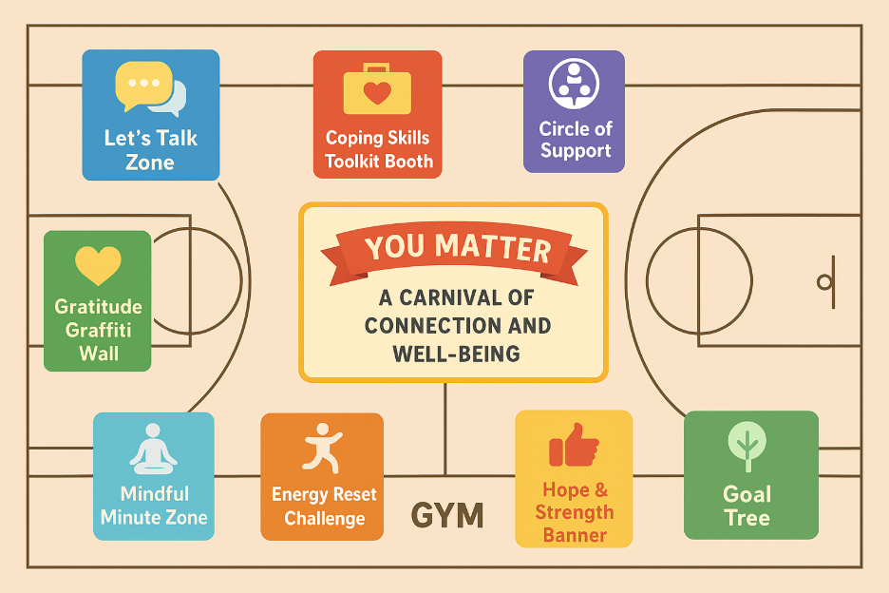
Floor map layout for Wellness Carnival
Open space can be used for the optional booths:
  Councilor Corner
  Resource booth

Slide 12
Activity Goals
Encouraging empathy and connection among students
Promote that small acts of kindness can go along way
Provide tools for recognizing signs of distress in peers
Normalize conversations about mental health and suicide prevention
Foster a sense of belonging and hope within the school community.

Slide 13
Program of Studies (POS) Connections
Station Name | Purpose | Grade 6 Outcomes | Grade 7 Outcomes | Grade 8 Outcomes | Grade 9 Outcomes
Sharing Circle | Build communication, empathy, and help-seeking skills through Indigenous education methods | R-6.2: Identify the qualities of positive relationships. W-6.8: Identify healthy ways of expressing feelings. | R-7.4: Demonstrate empathy and support for others. | R-8.3: Identify sources of support and develop strategies for seeking help. | R-9.3: Identify signs of emotional distress and how to access support.
Coping Skills Toolkit | Recognize healthy stress management and resilience strategies. | W-6.9: Identify positive methods of dealing with stress. | W-7.3: Apply strategies to manage stress effectively. | W-8.1: Demonstrate self-awareness and manage feelings in healthful ways. | W-9.3: Apply strategies to develop resilience and manage stress and change.
Circle of Support Station | Identify safe, supportive people and community resources. | R-6.5: Identify appropriate sources of help and support. | R-7.3: Identify characteristics of supportive relationships. | R-8.3: Identify sources of personal support and develop strategies for seeking help. | R-9.4: Identify community agencies and resources for support in crisis situations.
Gratitude Graffiti Wall | Cultivate positive mental health through gratitude. | W-6.7: Describe ways to build self-esteem. | W-7.1: Recognize personal strengths and achievements. | W-8.2: Appreciate the positive aspects of one’s life. | W-9.2: Demonstrate strategies for maintaining a positive self-image.
Mindful Minute Zone | Practice mindfulness, calm, and self-regulation. | W-6.9: Identify relaxation techniques. | W-7.3: Apply relaxation and self-regulation strategies. | W-8.1: Demonstrate awareness of the relationship between thoughts, feelings, and actions. | W-9.3: Apply strategies to maintain emotional balance and resilience.
Energy Reset Challenge | Connect physical activity to emotional well-being. | W-6.3: Describe how physical activity affects emotional well-being. | W-7.2: Explain the interconnection between physical, emotional, and social health. | W-8.2: Identify how exercise supports stress management. | W-9.2: Demonstrate personal responsibility for lifelong physical and mental wellness.
Hope & Strength Banner | Promote messages of resilience, belonging, and hope. | L-6.4: Recognize the importance of contributing to others’ well-being. | L-7.4: Identify ways of contributing to school and community. | L-8.4: Recognize how personal actions can contribute to positive change. | L-9.5: Develop a sense of purpose and recognize contributions to others.
Kindness Mailbox | Foster empathy, compassion, and connection. | R-6.2: Identify characteristics of positive relationships. | R-7.4: Demonstrate empathy and support for others. | R-8.3: Identify ways to show care and concern. | R-9.3: Demonstrate ways to contribute to others’ well-being.
Goal Tree | Encourage goal-setting and personal growth. | L-6.1: Set personal goals for improving well-being. | L-7.1: Set goals and develop a plan for achieving them. | L-8.3: Evaluate personal goals and strategies for success. | L-9.1: Identify short- and long-term goals for personal development.
Counsellor Corner | Provide a safe space for support and reflection. | R-6.5: Identify when and how to seek help. | R-7.3: Identify supportive school and community resources. | R-8.3: Identify sources of support for personal challenges. | R-9.4: Identify and access appropriate mental health supports.
Resource Booth | Provide access to community wellness resources. | L-6.4: Identify ways to contribute to one’s community. | W-7.5: Identify local health and support resources. | W-8.4: Demonstrate the ability to access reliable health information. | W-9.4: Identify and evaluate community health resources.

Slide 14
Program of Studies (POS) Connections Continued
Key Curriculum Strands Covered
  Wellness Choices (W) – Emotional and physical well-being, stress management, self-care.
  Relationship Choices (R) – Communication, empathy, healthy relationships, and support.
  Life Learning Choices (L) – Goal-setting, decision-making, and contribution to community.
Additional Integration Opportunities
  Language Arts: Reflective journaling about what wellness means to them.
  Art: Design wellness posters or gratitude art for display.
  Physical Education: Connecting Movement to Mental Health Benefits.
  Career and Technology Foundations (CTF): Leadership and community wellness projects.

Slide 15
Assessment
Students will hand in their wellness stamp cards during the final check-out to show completion and/or participation in the activity
Exit ticket- students can write down something they took away. This can be one thing students learned during the wellness carnival, how they are feeling after the carnival or a goal they may have to better support their peers

Slide 16
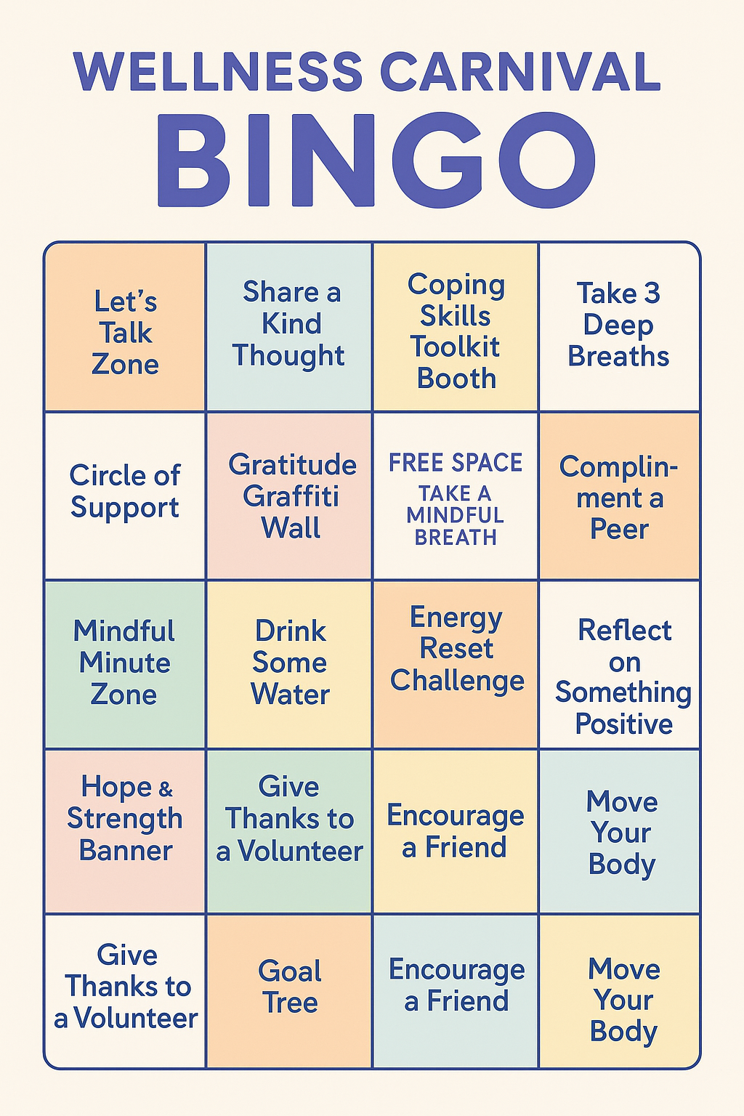
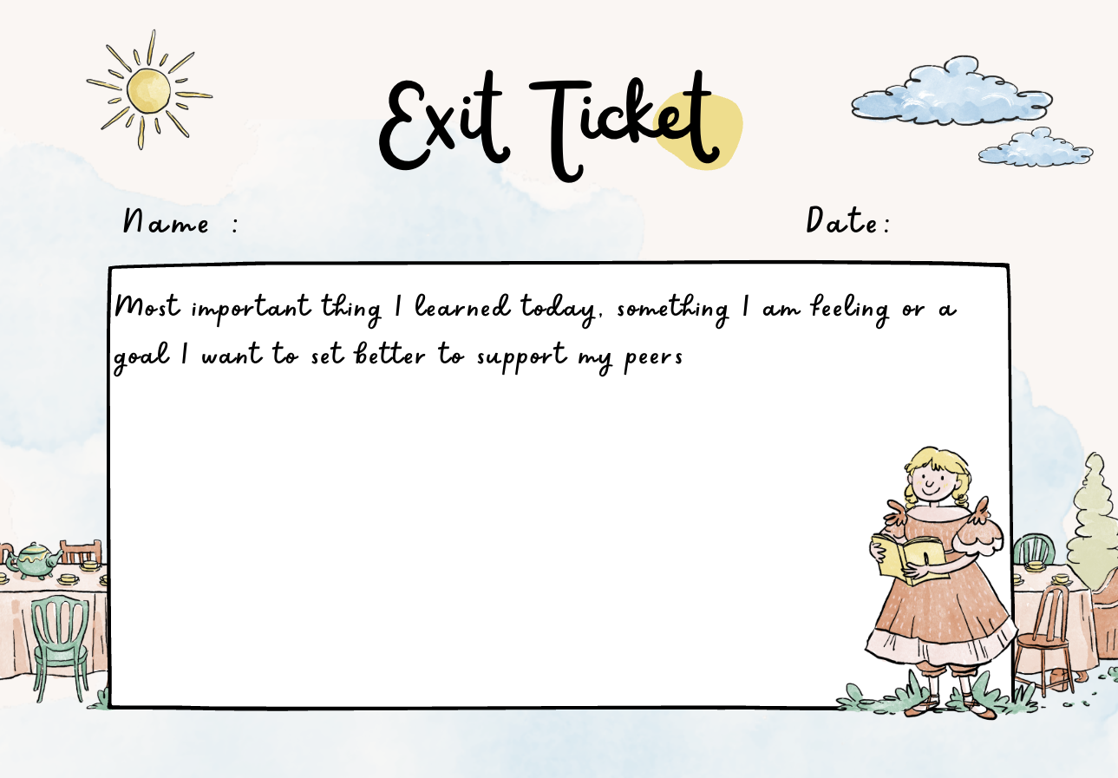

Slide 17
Assessment continued...
The day following the carnival students will complete a reflective piece on their learning
Such as a drawing/painting, journal entry, short response, poem. Students should choose a form of expression that is authentic to them

Slide 18
Assessment continued …..
Reflecting on Wellness, belonging and connection
Holistic reflection by using multiple ways of knowing as well as expressing learning, students can bring in their personal stories, connections into this reflection as well
“What does wellness look like for me now?”
“Which moment in the wellness carnival made me feel connected or supported?”
“How can I carry this sense of care and belonging forward?”

Slide 19
Assessment continued..
Program of studies outcomes for the reflective assessment
Health & Life Skills:
Apply strategies to manage stress and promote resilience.
Demonstrate empathy and support for others.
Set goals for personal well-being and reflect on growth.
Language Arts:
Express and reflect on ideas, feelings, and experiences through various forms.
Art:
Create visual representations that communicate meaning and emotion.

Slide 20
References
Alberta Education. (n.d.). Programs of study: Grades 6–9. Government of Alberta. https://www.alberta.ca/programs-of-study
Boyd, D. T., Gale, A., Quinn, C. R., Mueller-Williams, A. C., Jones, K. V., Williams, E., & Lateef, H. A. (2024). Do we belong? examining the associations between adolescents' perceptions of school belonging, teacher discrimination, peer prejudice and suicide. Journal of Racial and Ethnic Health Disparities, 11(3), 1454–1464. https://doi.org/10.1007/s40615-023-01622-5
ChatGPT. (2025, October 18). Wellness Carnival floor plan: A carnival of connection and well-being [Digital illustration]. OpenAI. https://chat.openai.com/
Donald, D. (2022). A Curriculum for Educating Differently: Unlearning Colonialism and Renewing Kinship Relations , 62(2).
Dueñas, J.-M., Morales-Vives, F., & de Oliveira, J. (2025). Beyond guidelines: Evaluating the realities of suicide prevention in schools. Children and Youth Services Review, 175(108363). https://doi.org/10.1016/j.childyouth.2025.108363
Gutiérrez, K. D. (2008). Developing a Sociocritical literacy in the third space. Reading Research Quarterly, 43(2), 148–164. https://doi.org/10.1598/rrq.43.2.3
O’Neill, J., Goldston, D. B., Kodish, T., Yu, S. H., Lau, A. S., & Asarnow, J. R. (2021). Implementing trauma informed suicide prevention care in schools: Responding to acute suicide risk. Evidence-Based Practice in Child and Adolescent Mental Health, 6(3), 379–392. https://doi.org/10.1080/23794925.2021.1917019
OpenAI. (2025, October 18). Suicide and wellness station ideas for a wellness carnival in a school gym (Grades 6–9, Alberta Program of Studies alignment) [Response generated by GPT-5]. ChatGPT. https://chat.openai.com/
Pruitt, D., & Kozik, P. (2022). Trauma, adversity, and the classroom teacher: Systematically planning for safety and resiliency. In Children and trauma: Critical perspectives for meeting the needs of diverse educational communities (pp. 37–54). Myers Education Press. https://ebookcentral-proquest-com.ezproxy.lib.ucalgary.ca/lib/ucalgary-ebooks/reader.action?docID=6955555&ppg=60&c=UERG

