Slide 1
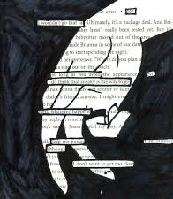
Blackout Poetry

Slide 2
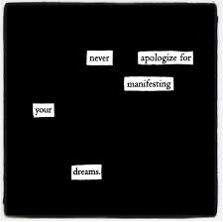
What is Blackout Poetry?
Blackout poetry is a form of erasure poetry, where you create a new poem by selecting words from an existing text and blacking out the rest.
The "found" words form a new poem, and the blacked-out areas can be used to create a unique visual art piece.
The goal is to change the original text and give it a new meaning.
Notes:
What is blackout poetry? Chances are, you have already seen blackout poetry in action: maybe it’s shown up on your social media timeline, or maybe you’ve read The New York Times’ Searching for Poetry series. Blackout poetry pages are easy to create, share, and celebrate, so it’s no wonder that their prominence coincided with the rise of social media.

Slide 3
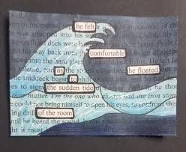
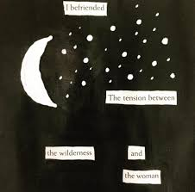
Examples

Slide 4
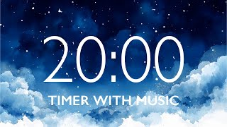
Activity
Find a text in a book that has interesting words.
Use a pencil to circle the interesting words you want to keep.
Once you have a basic outline (circled words) black out the rest of the words with a sharpie.
Erase pencil marks and read your poem.
Glue your poem to the construction paper and add it to your poetry anthology book.

Slide 5

Reflection
Can you tell me….
Which words did you decide to keep, and why?
What was the hardest part of deciding what to remove?
How does blackout poetry change the original meaning of the text?

